Slide 1
H.S 2ND YEAR(Arts)
POLITICAL SCIENCE
PART- A: Contemporary World Politics
Chapter 1:
THE COLD WAR ERA

Slide 2
WHAT WILL WE READ IN THIS CHAPTER…
What is Cold War…Meaning, Leaders
Background of cold war.. 2nd world war & Hiroshima , Nagasaki incident
Tension Areas..Cuban Missile Crisis

Slide 3
2
iv. DETTERENCE ….COLD WAR not HOT WAR
V. Military BLOCKS
VI. Disarmament Treaties
NAM- Emergence, NIEO, Relevance
Role of India in Cold War

Slide 4
What is Contemporary World Politics..
Incidents and political situation of the world since 1991.
It may be National, Regional and Global.

Slide 5
MEANING OF COLD WAR
Not direct conflict.
Conflict over IDEOLOGIES
It refers to the competition , tensions and a series of confrontation between the US and USSR.
CAPITALISM
(USA)
SOCIALISM
(USSR)

Slide 6
THE IDEOLOGIES
CAPITALISM SOCIALISM
FREE MARKET STATE CONTROLLED ECONOMY ECONOMY

Slide 7
COLD WAR not HOT WAR
DETTERENCE LOGIC
Possession of nuclear weapon by both the superpowers
Cost of using nuclear weapon
OTHER REASONS
Role of UNO
Disarmament Treaties

Slide 8
Background of Cold War
End of Second World War between
Allied powers and Axis power
USA,USSR,BRITAIN GERMAN, JAPAN, ITALY
FRANCE
. Atom Bomb IN Hiroshima and Nagasaki

Slide 9
TENSION AREAS
CUBAN MISSILE CRISIS
CONGO WAR
AFGHANISTAN WAR
KOREAN WAR
Berlin crisis

Slide 10
MILITARY BLOCKS
North Atlantic Treaty Organization or NATO-1949:
WARSAW-1955:
SEATO- South East Asian Treaty Organisation
CENTRO- Central Treaty Organisation

Slide 11
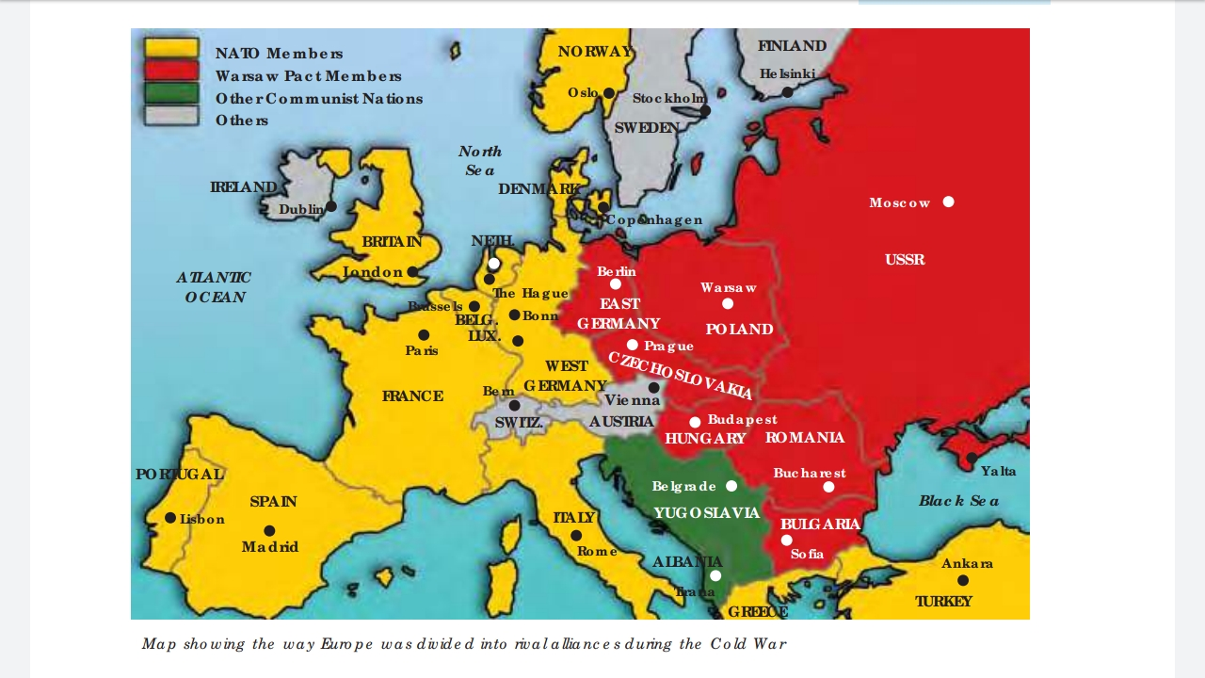
NATO, WARSAW ETC…

Slide 12
Why did the Small States join the BIG POWER…
Big power promised protection and security to them.

Slide 13
What did the big powers receive from the small states…
Natural resources like oil, minerals
Territory to have military base
Spying
Markets to sell weapons
and
Expanded their belief or ideology in order to win the battle of ideology.

Slide 14
Disarmament Treaties
Limited Test Ban Treaty, 1963
Non proliferation Treaty 1968
SALT I, SALT II, 1972, 79

Slide 15
NAM
A group of countries (gained independence after second world war)who did not join both the power blocks and tried to remain independent.
FIVE PILLARS OF NAM
INDIA EGYPT GHANA INDONESIA YUGOSLOVIA
Nehru Nasser K. Nkrumah Sukarno Tito

Slide 16
Aim of NAM
To maintain independence having equal distance from both the super powers
To oppose Colonisation and Decolonisation
To provide a common platform to the third world and newly independent countries
TO REDUCE THE TENSION OF COLD WAR.
NIEO

Slide 17
NIEO
RESTRUCTURING OF EXISTING ECONOMIC ORDER
GRANT OF INTERNATIONAL DEVELOPMENTAL AID
INCREASED SHARE IN WORLD TRADE
JUSTICE AND EQUALITY IN WORLD ECONOMIC ORDER

Slide 18
RELEVANCE OF NAM IN POST COLD WAR ERA
It provides common platform to the third world countries to discuss and solve their problems.
It still can play a very important role in protecting the third world countries from decolonisation.

Slide 19
India’s Role in Cold War
Two fold role-
First, it maintained a distance from both the super powers AND THEREBY HELPED IN PREVENTING THE SPREAD OF COLD WAR IN NEW AREAS.
Second, it tried to reduce the tension between the two superpowers either individually or through NAM.

Slide 20

THANK YOU

