Slide 1
CELL JUNCTIONS
Presented by
Darathi Deori

Slide 2
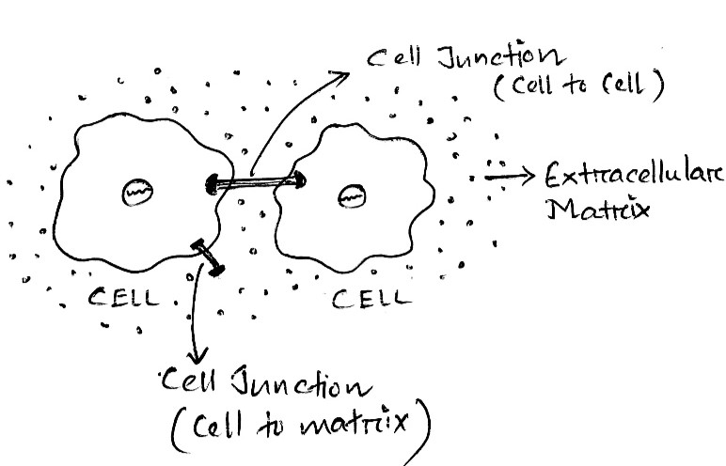
INTRODUCTION
Definition :
The cell junction is a cell-cell or cell-extracellular matrix contact within a tissue of a multicellular organism, especially abundant in epithelia.
These junctions are critical to the development and functions of multicellular organisms.
Combined with cell adhesion molecules and extracellular matrix(ECM),Cell junctions help hold animal cells together.
Fig: Cell junction between cell-cell and cell -ECM

Slide 3
TYPES OF CELL JUNCTION
1.Occluding junctions
2.Anchoring junctions
3.Communicating junctions

Slide 4
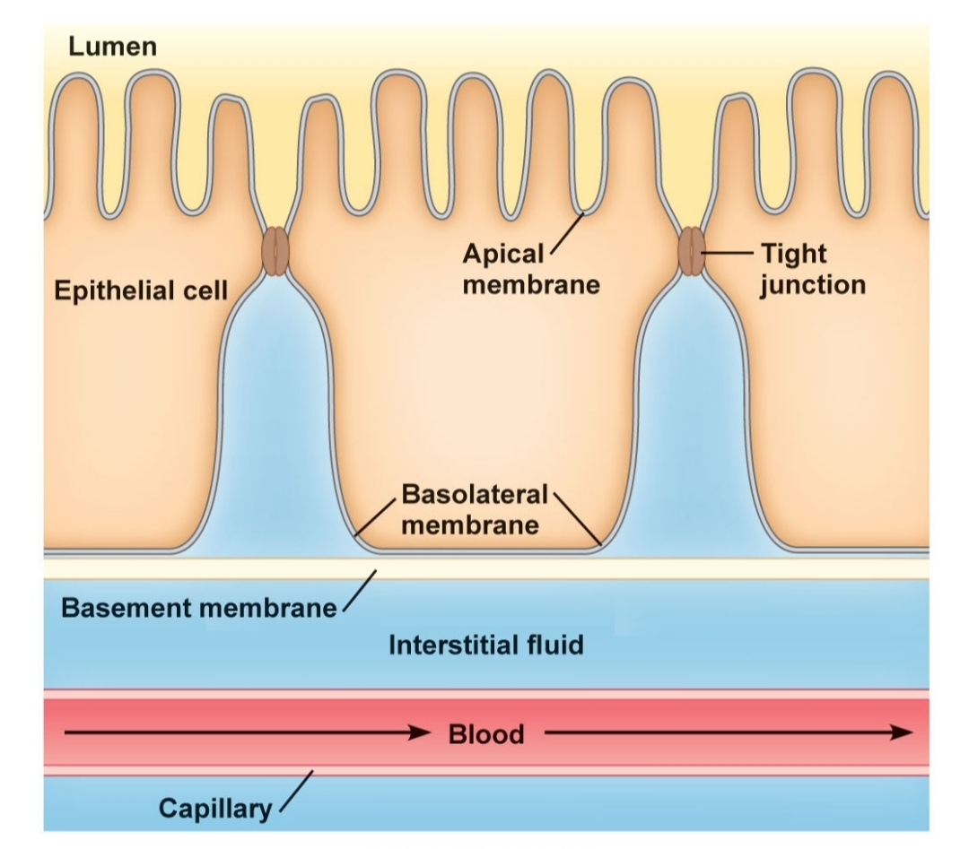
OCCLUDING JUNCTIONS
Occluding junctions forms permeability barrier across epithelial cell sheets.
They are of two types- Tight junction(or Zonula occludens) and Septate junction.
a) Tight Junction:
Cell-cell occluding junctions mediated by transmembrane proteins( claudin, occludin) and intracellular membrane protein called ZO protein.
Make the closest contact between adjacent cells and prevent the free passage of molecules(Including ions) across an epithelial sheet in the space between cells.
Maintain the polarity of epithelial cells.

Slide 5
b) Septate Junctions:
Septate junctions(SJ)are the main occluding junctions in invertebrates.
They perform the same function in invertebrates that tight junctions perform in vertebrates (Banerjee et.al.,2006).
They are located basolateral to the adherens junction.
They form paracellullar barrier to solute diffusion through the intercellular space.

Slide 6
ANCHORING JUNCTIONS
Anchoring junctions attach cells(and their cytoskeletons) to their neighbours or to the extracellular matrix.
It includes two main type of junctions-Adherens Junction and Desmosome .
a) Adherens Junctions – Provide strong mechanical attachments between adjacent cells through the linkage of cytoplasmic face with cytoskeleton.
Types-
Adhesion belt (or Zonula adherens):
Cell-cell junction, mediated by actin filaments and proteins belonging to cadherin family.
Located near the apical surface, just below the tight junctions.
Focal contact(or adhesion plaque):
Cell-matrix junction mediated by transmembrane adhesion proteins of the integrin family and by actin filament.

Slide 7
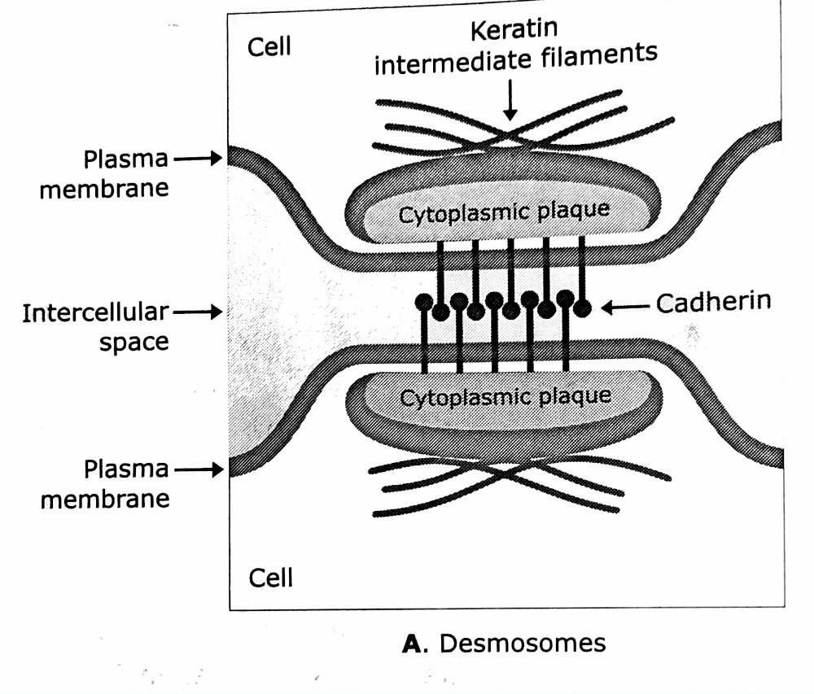
b) Desmosomes:
Form links between cells and provide a connection between intermediate filaments of the cells cytoskeletons of adjacent cells.
It has a dense cytoplasmic plaque made of attachment proteins (plakoglobin and desmoplakin) along with cadherin proteins (desmoglein and desmocollin) acting as the transmembrane linker proteins.

Slide 8
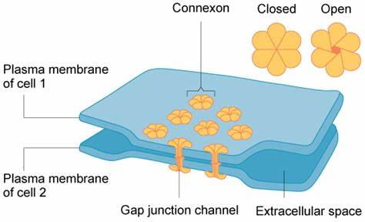
COMMUNICATING JUNCTIONS
Allow the passage of chemical and electrical signals from one cell to another.
They are of two types- Gap and Plasmodesmata .
a) Gap Junctions:
Direct connections between the cytoplasms of adjacent cells. Allow passage of inorganic ions and water soluble molecules of up to 100d to pass directly from one cell to another.
Consists of transmembrane proteins called Connexins. Six connexins assemble in a cylindrical manner to form a pore called connexon. Connexons from two cells form a continuous aqueous channel called gap junction, which connect the two cell interior.

Slide 9
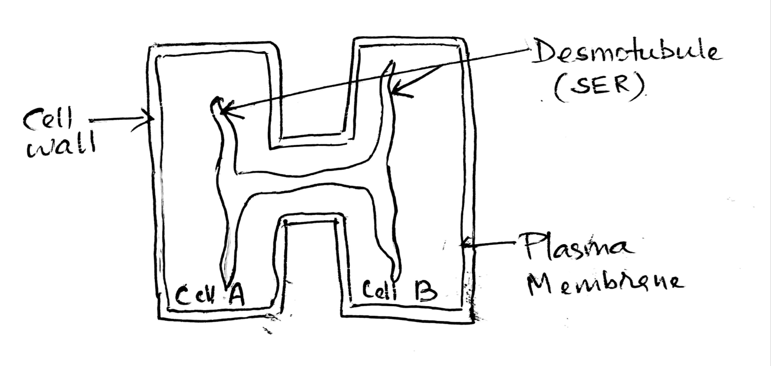
b)Plasmodesmata:
They are communicating junctions found in plant cells. Adjacent plant cells communicate with each other through cytoplasmic connections called plasmodesmata.
They are analogous to animal cell’s gap junctions, but are structurally unrelated.
Plasmodesmata is formed by an extension of smooth endoplasmic reticulum called desmotubule.
Fig: Plasmodesmata

Slide 10
SUMMARY
Junction type( vertebrate) | Function
Tight junction | Seals neighboring cells together in an epithelial sheet to prevent leakage of molecules between them.
Adherens junction | Connect bundles of actin filaments from cell to cell(Adhesion belt) or from cell to the extracellular matrix(Focal contact).
Desmosome | Joins the intermediate filaments in one cell to those in a neighbor.
Gap junction | Allow the passage of small water-soluble ions and molecules from the cytoplasm of one cell to the cytoplasm of the other.
Plant cells are connected and communicate with each other via Plasmodesmata.
Septate junctions are the main occluding junction in invertebrates.

